Slide 1
Cricsheet Match Data Analysis
Visual Insights from International and League Cricket
Presented by Jaisrinivas P K

Slide 2
Project Summary
This project analyzes cricket match data scraped from cricsheet.org. The dataset includes 11,000+ matches across formats like Tests, ODIs, T20Is, and IPL.
Transformed data into structured tables
We built visualizations using Python libraries like Matplotlib, Seaborn, and Plotly to uncover trends in player and team performance.

Slide 3
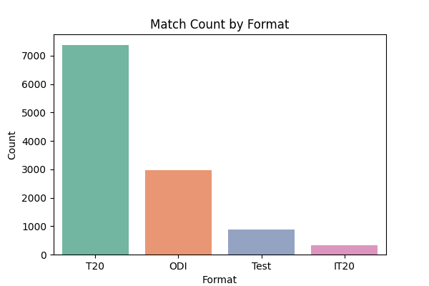
Match Count by Format
Test matches dominate in terms of volume, followed by ODIs and T20s. Useful for understanding the dataset’s distribution.

Slide 4
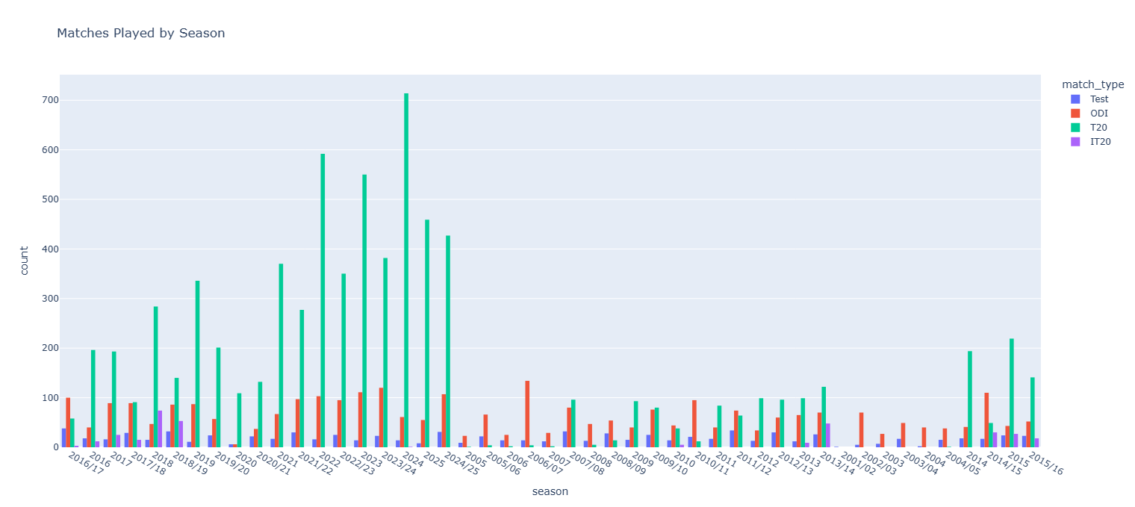
Matches Over the Seasons
Cricket matches have steadily increased over the years, with a visible rise in T20 leagues like IPL post-2008.

Slide 5
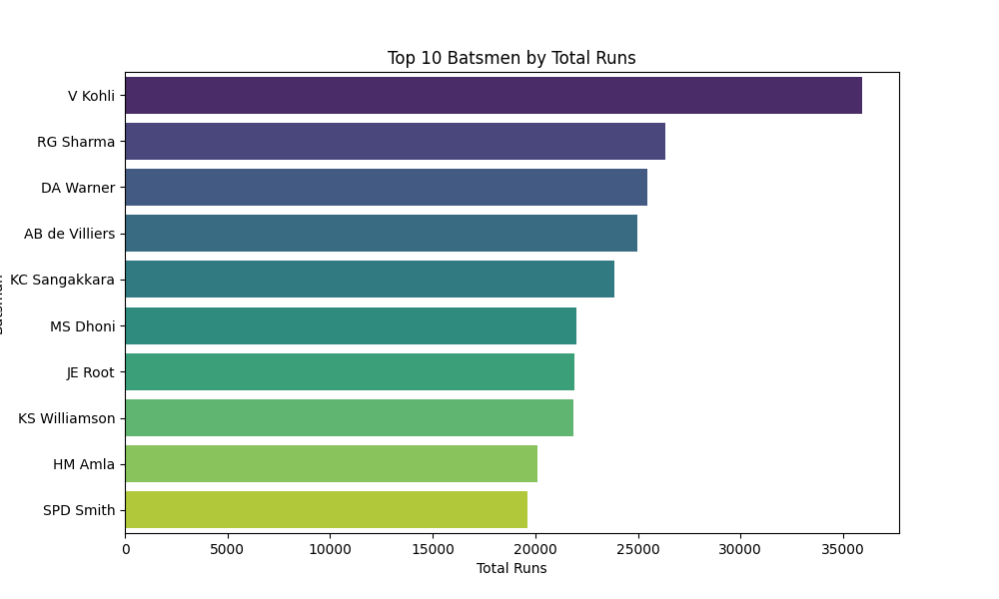
Top 10 Batsmen by Runs in ODIs
Virat Kohli leads the run charts in ODIs, followed by Rohit Sharma. This reflects consistency across long careers.

Slide 6
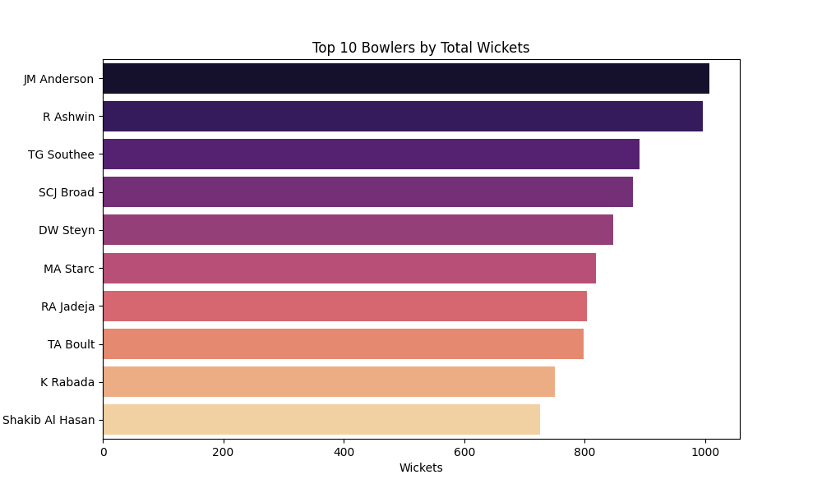
Top Wicket Takers
James Anderson, Broad, and Lyon are among the most successful bowlers in Tests.

Slide 7
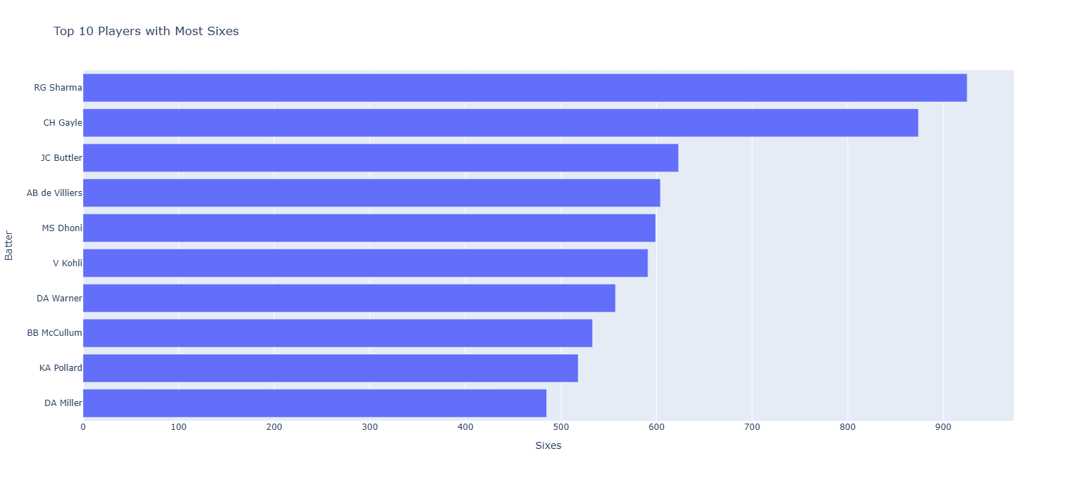
Top Six Hitters
Rohit Sharma and Chris Gayle dominate the six-hitting leaderboard across ODIs and T20s.

Slide 8
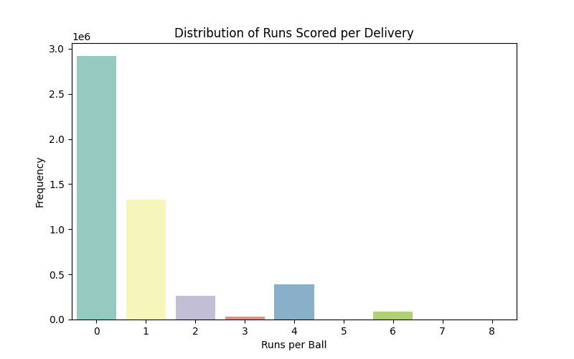
Distribution of Runs per Ball
Dot balls are most common, followed by singles and boundaries—highlighting the balance of risk vs. rotation.

Slide 9
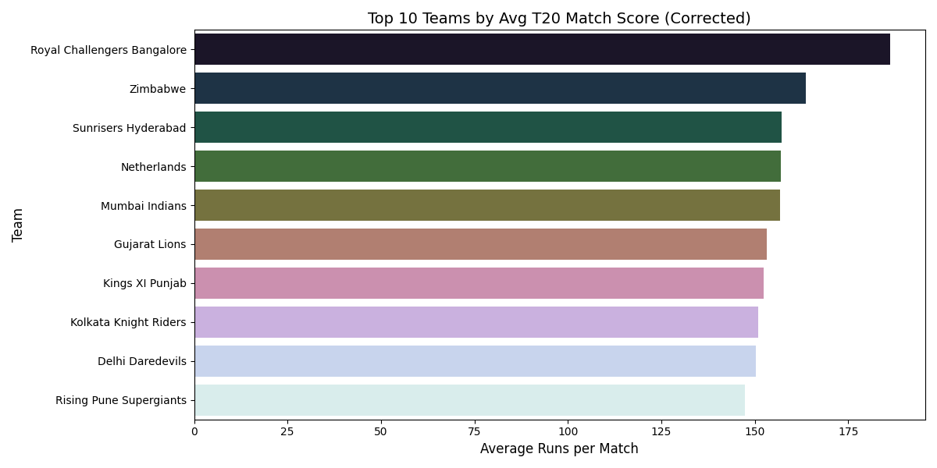
Top T20 Teams by Average Score
RCB top the scoring charts with average team totals above 175 runs.

Slide 10
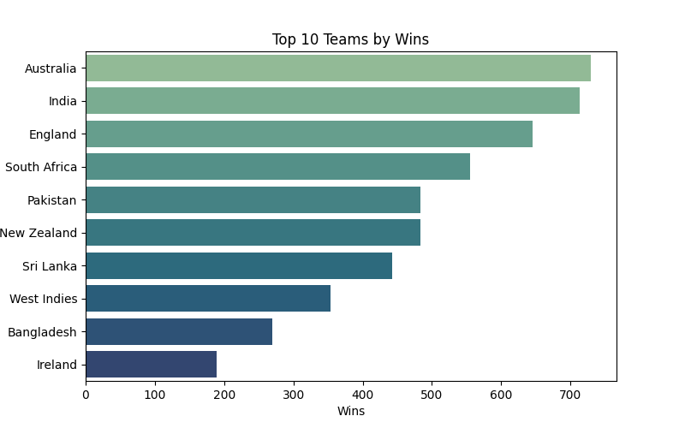
Teams with the Most Wins
Australia and India lead the pack in total wins across formats.

Slide 11
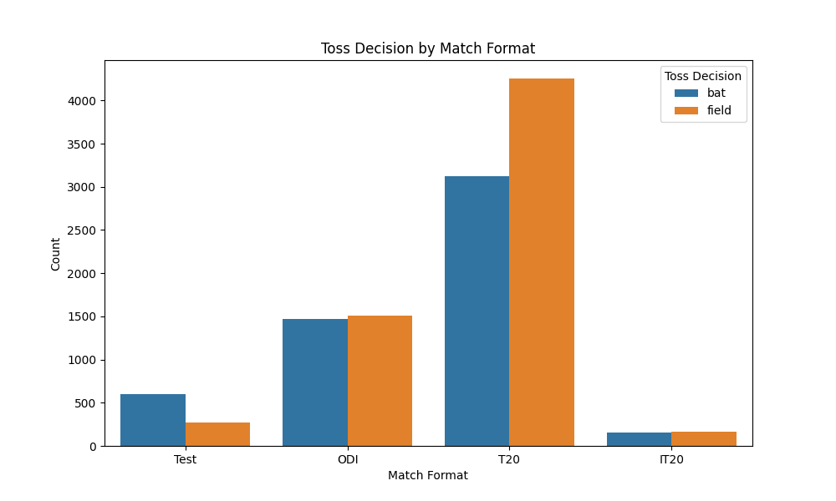
Toss Decision Trends
Teams prefer to bat first in Tests, while chasing is popular in T20s and ODIs.

Slide 12
Tools & Tech Used
Python: Data processing (Pandas, JSON)
Selenium: Scraping from Cricsheet
SQLite: Data storage
Matplotlib, Seaborn, Plotly: Visualization
PowerPoint: Manual report presentation

